Slide 1
Stacks

Slide 2
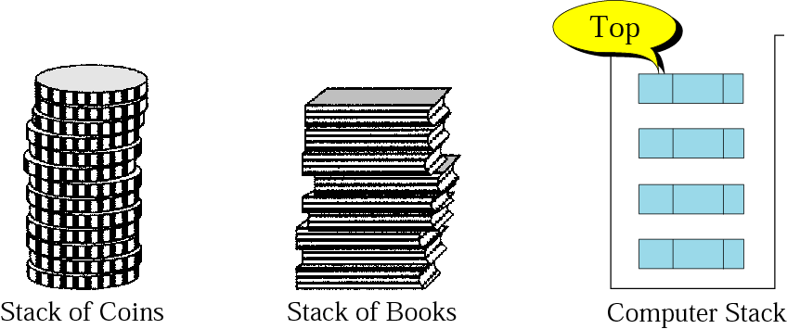
Overview
Stack
A stack is a linear data structure or abstract data type for collection of items, with the
restriction that items can be added one at a time and can only be removed in the
reverse order in which they were added.
The last item represents the top of the stack
It is also known as LIFO (Last In First Out) or FILO(First In Last Out) data structure.
Example: Pile of plates, Pile of books etc.
TOP

Slide 3
Basic Operations
The common operations associated with a stack are as follows:
push: adds a new item on top of a stack.
pop: removes the item from the top of a stack
isEmpty: Check to see if the stack is empty
isFull: Check to see if stack is already full
returnTop: Indicate which item is at the top

Slide 4
Example
Insert
ABCDE
Delete
EDC
E
TOP
D
C
B
B
TOP
A
A

Slide 5
Implementation
Stack can be implemented in two ways –
Using array
Using linked list

Slide 6
Array as Stack
Create stack
C code: #define SIZE 10
struct stack{
int array[SIZE];
int TOP;
};
Initialize stack:
Algorithm Init_Stack (struct stack* STK): This algorithm initializes a stack with TOP = -1. Here, STK is a pointer to a structure. TOP represents the index of the last item in a stack.
1. STK -> TOP = -1 // -1 means stack is empty

Slide 7
Illustration
SIZE = 8 Push 8, 56, 57, 7, 56, 9
0
1
2
3
4
5
6
7
5
8 | 56 | 57 | 7 | 56 | 9
TOP
Push 89, 90
7
8 | 56 | 57 | 7 | 56 | 9 | 89 | 90
TOP
Push 34
Stack Overflow
4 Times Pop
3
8 | 56 | 57 | 7
TOP

Slide 8
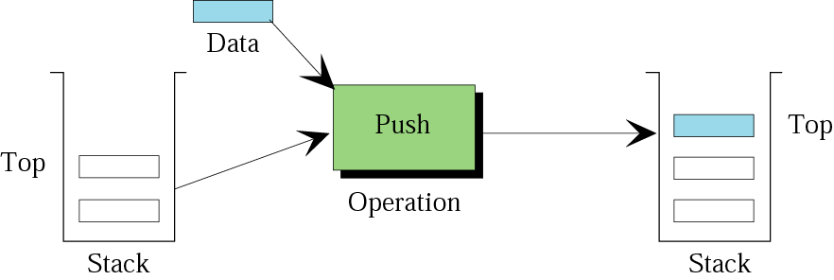
Push operation

Slide 9
Push operation
Below mentioned algorithm inserts an element into stack STK. Item is an element which is to be inserted.
Algorithm Push(struct stack* STK, int Item)
If(STK -> TOP == (SIZE – 1)) \\ Check overflow condition
Display “Stack is full”
return
STK -> TOP = STK -> TOP + 1
STK -> array [STK ->TOP] = Item
Time Complexity = O(1)

Slide 10
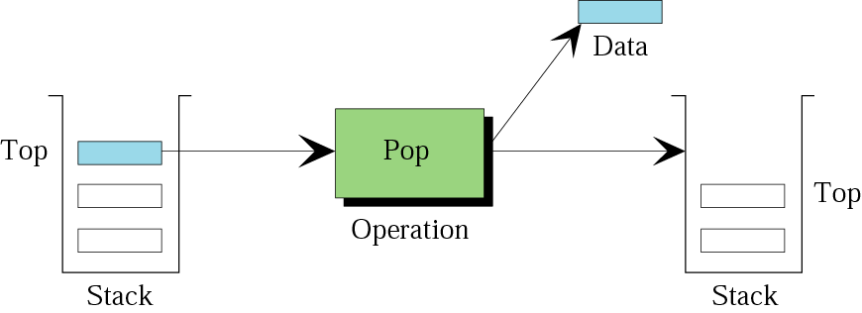
Pop operation

Slide 11
Pop operation
This algorithm returns an element from stack TOP. Item is local variable.
Algorithm Pop(struct stack * STK)
If(STK -> TOP == – 1) \\ Check underflow condition
Display “Stack is empty”
Return
Item = STK -> array [STK ->TOP]
STK ->TOP = STK ->TOP - 1
Return Item
Time Complexity = O(1)

Slide 12
Printing Stack
This algorithm prints all the elements of stack.
Algorithm Print(struct stack * STK)
If(STK -> TOP == – 1) \\ Check underflow condition
Display “Stack is empty”
Return
For (i= STK ->TOP ; i>=0;i=i-1)
Printf (“%d \n”, STK -> array [i]);
Time Complexity = O(n)

Slide 13
Limitation
Size of stack must be known in advance. However in real scenario it is not possible.
Stack growth should not restricted to finite number of
elements.

Slide 14
Linked List
as
Stack

Slide 15
Create stack
C code:
struct Node{
int INFO;
struct Node *NEXT;
};
Initialize stack:
Algorithm Init_LStack( struct Node *TOP): This algorithm initializes a stack by creating empty linked list. TOP represents the last item of stack and pointing to empty linked list.
1. TOP = NULL // NULL means stack is empty

Slide 16
Illustration
Push 8, 56, 57
1. Push 8
8 | NULL
TOP
2. Push 56
56
8 | NULL
TOP
3. Push 57
57
56
8 | NULL
TOP

Slide 17
Push operation
This algorithm inserts an element into stack by inserting as first node into linked list. Item is element which is to be inserted. TOP is pointing to last inserted node i.e. first node of linked list.
Algorithm Lpush(struct Node *TOP, int Item)
struct Node *New_Node
New_Node = Allocate memory
If(New_Node == NULL) \\ Check overflow condition
Display “Unable to allocate memory”
Exit //return
New_Node -> INFO = Item
New_Node ->NEXT = TOP
TOP = New_Node
Time Complexity = O(1)

Slide 18
Illustration
57
56
8 | NULL
TOP
1. Pop
56
8 | NULL
TOP
2. Pop
8 | NULL
TOP
3. Pop TOP = NULL
4. Pop Underflow

Slide 19
Pop operation
This algorithm deletes and returns an element from stack TOP. Item is local variable.
Algorithm LPop(struct Node *TOP)
struct Node *Temp
Temp = TOP
If(TOP == NULL) \\ Check underflow condition
Display “Stack is empty”
Return NULL
Item = Temp ->INFO
TOP = Temp -> NEXT
Free Temp
Return Item
Time Complexity = O(1)

Slide 20
Print operation
Algorithm Print(struct Node *TOP ): This algorithm prints the stack
Node* Temp=TOP
While(Temp!=NULL)
printf(“%d\n”,Temp->INFO);
Temp=Temp->NEXT;
Time Complexity = O(n)

Slide 21
Applications
Stack is one of the most commonly used data structure.
Calling Function –The most fundamental use of stacks relates to how functions are called. One function can call another function which can call a third and so on.
When a call is made one method of passing arguments to a function is to push the data onto the stack along with the address of the program statement where control should return to after competition of function.
Recursive Function – Function calls itself, the parameter, local variable status return address where control is to be return are saved in stack.
Expression Conversion : Infix to postfix, Infix to prefix etc.
Arithmetic Expression Evaluation : postfix expression evaluation etc.
Parentheses matching
Tower of Hanoi

Slide 22
Arithmetic Expression Evaluation
Assume that given expression does not contain any unary operator.
For same level operations, precedence are performed from left to right.
Operations | Precedence
Exponential (↑) | 4
Multiplication (*) | 3
Division (/) | 3
Modulus (%) | 3
Addition (+) | 2
Subtraction (-) | 2
Left Parenthesis | 1
Right Parenthesis | 1
NOTE: Higher the number higher the precedence.

Slide 23
Polish Notations
An arithmetic expression may be in the following forms –
Infix – Operator symbol is placed in between its two operands like X + Y
Prefix – Operator symbol is placed before its two operands like + X Y
Postfix – Operator symbol is placed after its two operands like X Y +
In our usual practice, we solve the expressions in infix form.
But, for computer program it is very complex to solve an expression in infix form.
Therefore, to evaluate arithmetic, first system converts it into prefix or postfix form.

Slide 24
Expression Conversion
Following conversions are possible –
Infix to postfix
Infix to prefix
Postfix to infix
Prefix to infix

Slide 25
Infix to Postfix
Algorithm Infix_To_Post (InFix) – This algorithm takes infix expression and returns equivalent postfix expression.
Create empty stack, say STK
While (!(InFix END))
pick an element from InFix and say it is Current
If (Current == left Parenthesis)
Push(STK, Current)
Else If (Current == right Parenthesis)
While (!(isEmpty(STK)) && STK -> array [STK ->TOP] != left Parenthesis)
Operator = Pop(STK)
AppendTo(PostFix, Operator)
Pop(STK) // remove the left parenthesis and do not append to PostFix
Else If(Current == Operand)
AppendTo(PostFix, Current)

Slide 26
13. Else If (Current == Operator)
While (!(isEmpty(STK)) && PREC(Current) <= PREC(STK->array[STK->TOP]))
Operator=Pop(STK)
AppendTo(PostFix, Operator)
Push(STK, Current)
Else
Display “Incorrect Expression”
Exit
While (!(isEmpty(STK)) && STK -> array [STK ->TOP] != left Parenthesis)
Operator = Pop(STK)
AppendTo(PostFix, Operator)
If (STK -> array [STK ->TOP] == left Parenthesis)
Display “Incorrect Expression”
Exit

Slide 27
Illustration
InFix Expression –
(A – B) * (C / D)
Current Character | PostFix Expression | Stack
( |  | (
A | A | (
- | A | ( -
B | A B | ( -
) | A B - | Empty
* | A B - | *
( | A B - | * (
C | A B – C | * (
/ | A B – C | * ( /
D | A B – C D | * ( /
) | A B – C D / | *
End of expression | A B – C D / * | Empty

Slide 28
Exercises
InFix Expression –
1. A + B * C - D / E
2. A * B - ( C + D ) + E
3. A + (B * C – (D / E ↑ F) * G) * H
PostFix Expression –
1. A B C * + D E / -
2. A B * C D + - E +
3. A B C * D E F ↑ / G * - H * +

Slide 29
Infix to Prefix
Algorithm Infix_To_Pre (InFix) – This algorithm takes infix expression and returns equivalent prefix expression.
Create empty stack, say STK
RInFix = Reverse(InFix)
While (!(RInFix END))
pick an element from RInFix and say it is Current
If (Current == right Parenthesis)
Push(STK, Current)
Else If (Current == left Parenthesis)
While (!(isEmpty(STK)) && STK->array[STK->TOP] != right Parenthesis)
Operator = Pop(STK)
AppendTo(PreFix, Operator)
Pop(STK) // remove the right parenthesis and do not append to PreFix
Else If(Current == Operand)
AppendTo(PreFix, Current)

Slide 30
13. Else If (Current == Operator)
While (!(isEmpty(STK)) && PREC(Current) < PREC(STK->array[STK->TOP] )
Operator=Pop(STK)
AppendTo(PreFix, Operator)
Push(STK, Current)
Else
Display “Incorrect Expression”
Exit
While (!(isEmpty(STK)) && STK->array[STK->TOP] != right Parenthesis)
Operator = Pop(STK)
AppendTo(PreFix, Operator)
If (STK->array[STK->TOP] == right Parenthesis)
Display “Incorrect Expression”
Exit
PreFix = Reverse(PreFix)
Return Prefix

Slide 31
Illustration
InFix Expression – (A – B) * (C / D)
Reversed expression )D / C( * )B – A(
Current Character | PreFix Expression | Stack
) |  | )
D | D | )
/ | D | ) /
C | D C | ) /
( | D C / | Empty
* | D C / | *
) | D C / | * )
B | D C / B | * )
- | D C / B | * ) -
A | D C / B A | * ) -
( | D C / B A - | *
End of Expression | D C / B A - * | Empty
Final PreFix
* - A B / C D

Slide 32
Exercises
InFix Expression –
1. A + B * C - D / E
2. A * B - ( C + D ) + E
3. A + (B * C – (D / E ↑ F) * G) * H
PreFix Expression –
1. - + A * B C / D E
2. + - * A B + C D E
3. + A * - * B C * / D ↑ E F G H

Slide 33
Postfix to Infix Conversion
Algorithm Postfix_To_Infix (PostFix) – This algorithm takes postfix expression and returns equivalent infix expression. In this case, we push and pop the strings. str1, str2 are the temporary variables holding strings.
Create empty stack, say STK
While (!(PostFix END))
pick an element from PostFix and say it is Current
If(Current == Operator)
str2 = Pop(STK) // this becomes right operand
str1 = Pop(STK) //this becomes left operand
Concatenate str1, Current, and str2 // str=str1+ Current +str2
Enclose str with parenthesis
Push(STK, str)
Else
Push(STK, Current)
InFix = Pop(STK)

Slide 34
Postfix to Infix Conversion Illustration
PostFix Expression - A B C * D E / - +
C
B
A
D
(B * C)
A
B
A
(B * C)
A
A
E
D
(B * C)
A
(D / E)
(B * C)
A
((B * C) – (D / E))
A
(A + ((B * C) – (D / E)))
InFix Expression - (A + ((B * C)– (D / E)))

Slide 35
Evaluation of Postfix Expression
We follow the same algorithm that converts Postfix to infix.
Here, we compute each binary operation and then push the result into the stack.
Example –
2 3 – 1 + 4 3 * + =
12
3
2
2 – 3 = -1
3
4
0
12
0
12
-1
1
-1
0
4
0

Slide 36
Exercises
Infix
((9 * 9) – 81) = 0
((2 * 2 ) – 3) = 1
(((7 * (6 ^ 2)) / 4) – 8) = 55
PostFix
9 9 * 81-
2 2 * 3 –
7 6 2 ^ * 4 / 8 -
PostFix Expression –
1. A B C * + D E / -
2. A B * C D + - E +
3. A B C * D E F ↑ / G * - H * +

Slide 37
Prefix to Infix Conversion
Algorithm Prefix_To_Infix (PreFix) – This algorithm takes prefix expression and returns equivalent infix expression. In this case, we push and pop the strings. str1, str2 are the temporary variables holding strings.
Create empty stack, say STK
RPreFix = Reverse (PreFix) // reverse
While (!(RPreFix END))
pick an element from PreFix and say it is Current
If(Current == Operator)
str1 = Pop(STK) //here str1 becomes left operand
str2 = Pop(STK) //here str2 becomes right operand
Concatenate str1, Current, and str2 // str=str1+ Current + str2
Enclose str with parenthesis
Push(STK, str)
Else
Push(STK, Current)
InFix = Pop(STK)

Slide 38
Prefix to Infix Conversion Illustration
PreFix Expression - * - A B / C D
Reversed Expression is D C / B A - *
A
B
(C / D)
C
D
(C / D)
B
(C / D)
D
(A – B)
(C / D)
((A – B) * (C/D))
InFix Expression - ((A – B) * (C / D))

Slide 39
Exercises
PreFix Expression –
1. - + A * B C / D E
2. + - * A B + C D E
3. + A * - * B C * / D ↑ E F G H

Slide 40
Evaluation of Prefix Expression
We follow same algorithm that converts Prefix to infix.
Here, we compute each binary operation and then push the result into the stack
Example –
+ - 4 2 3
Reverse
3 2 4 - +
Infix:
((4 - 2) + 3) = 5
4
2
3
4 - 2 =2
2
3
5

Slide 41
Exercises
Infix
((9 * 9) – 81) = 0
(((2 – 3) + 1) + ( 4 * 3)) =12
PreFix
- * 9 9 81
+ + - 2 3 1 * 4 3

Slide 42
Parentheses matching
Algorithm Check_For_Balanced_Paranthesis (Exp) –Algorithm to check whether given expression contains balanced parentheses.
Create empty stack, say STK
While (!(ExpEND))
pick an element from Exp and say it is Current
If( Current == ‘(‘ || Current == ‘{‘ ||Current == ‘[‘ )
Push(STK, Current)
Else if (Current == ‘)‘ || Current == ‘}‘ ||Current == ‘]‘ )
if (IsEmpty(STK) // stack is empty
Print “not balanced ”
Exit
X=Pop()
if (X is not a matching opening bracket ) // Eg. Current is ‘)’ & X is not ‘(‘
Print “not balanced ”
Exit
If (there is some opening brackets left in stack)// if stack is not empty
Print “not balanced ”
Else
Print “Balanced ”

